Slide 1
Digital Portfolio
STUDENT NAME: Santhosh R
REGISTER NO AND NMID: asunm1112401111058045
DEPARTMENT: computer science
COLLEGE: L.N. Government College , Madras University .

Slide 2
PROJECT TITLE
Digital portfolio Using front end web development

Slide 3


AGENDA
Problem Statement
Project Overview
End Users
Tools and Technologies
Portfolio design and Layout
Features and Functionality
Results and Screenshots
Conclusion
Github Link
3/21/2024 Annual Review

Slide 4

PROBLEM STATEMENT
1.Students need a professional way to showcase their skills and achievements.
2. Traditional resumes are static and limit interactive presentation.
3. A digital portfolio provides a modern and dynamic alternative.
4. It highlights personal details, skills, and certifications attractively.
5. The website is responsive, user-friendly, and visually appealing.
6. This solution helps students present themselves effectively to recruiters.

Slide 5

PROJECT OVERVIEW
This project is a personal portfolio website for students.
2. It is built using HTML, CSS, and JavaScript.
3. The site showcases academic details, skills, and certifications.
4. It includes sections like About Me, Skills, and Contact.
5. The design is responsive, interactive, and visually appealing.
6. It acts as a modern digital resume for opportunities.

Slide 6

WHO ARE THE END USERS?
The portfolio is mainly created for recruiters and employers.
2. It also helps professors and mentors assess student achievements.
3. Event organizers can use it to verify participation and skills.
4. Peers can explore the portfolio for collaboration opportunities.
5. The student benefits by building a strong digital presence.
6. Overall, it serves anyone interested in the student’s profile.

Slide 7

TOOLS AND TECHNIQUES
HTML5 is used to structure the portfolio content.
2. CSS3 styles the website with layouts and designs.
3. JavaScript adds interactivity and dynamic effects.
4. Code editors like VS Code help in development.
5. Browsers are used to test and debug the site.
6. GitHub can be used to host and manage the project.

Slide 8
POTFOLIO DESIGN AND LAYOUT
The portfolio uses a clean and structured HTML design.
2. CSS gradients and shadows give it a modern look.
3. Flexbox and Grid ensure a responsive layout.
4. JavaScript adds smooth scrolling and animations.
5. Media queries adapt the site to different screen sizes.
6. Hover effects and styled cards improve user experience.
8

Slide 9
FEATURES AND FUNCTIONALITY
The portfolio highlights profile, skills, and certifications.
2. It provides a clean, responsive design for all devices.
3. Certificates include links for verification online.
4. Smooth scrolling and animations enhance user experience.
5. The footer gives direct contact details with icons.
6. It functions as a digital resume for students and recruiters.

Slide 10
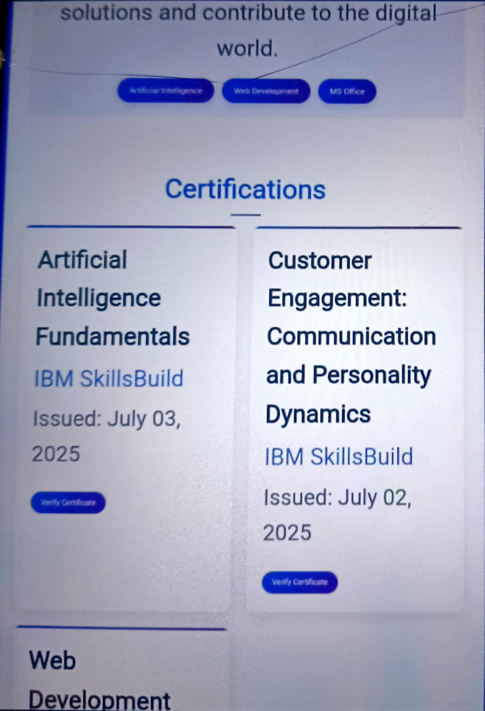
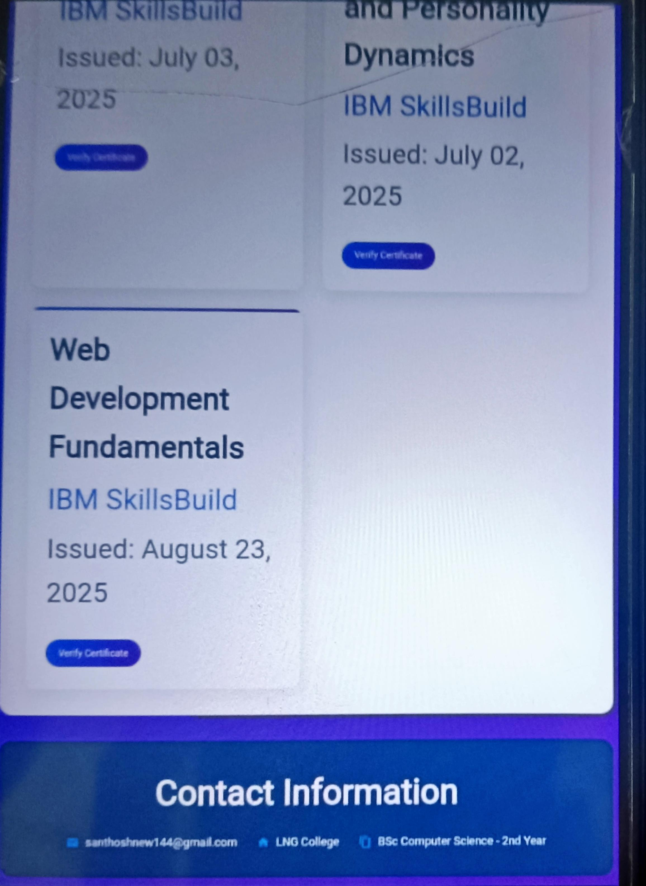
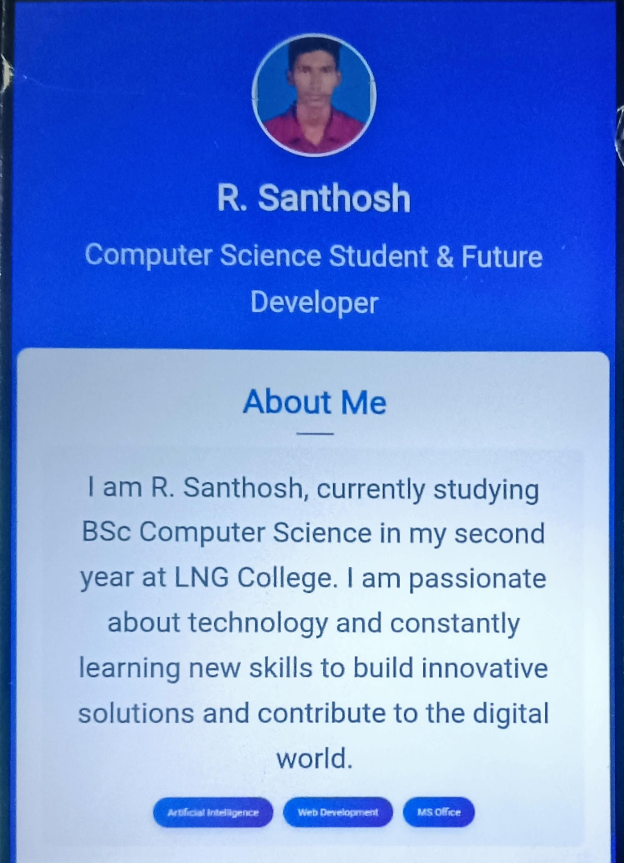

RESULTS AND SCREENSHOTS
3/21/2024 Annual Review
10

Slide 11
CONCLUSION
The portfolio presents academic and personal details neatly.
2. It highlights skills, achievements, and certifications.
3. Modern design ensures clarity and easy navigation.
4. Responsive features make it accessible on all devices.
5. It acts as a professional digital resume.
6. The portfolio supports future updates and growth.
11

Slide 12
Digital portfolio
https://santhoshnew144-hub.github.io/TNSDC-FWD-DP/

